Slide 1
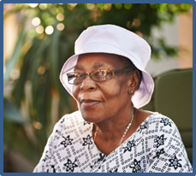


Recognizing the Role of Diversity in Dementia Care
MODULE 3
U.S. Department of Health and Human Services
Health Resources and Services Administration
October 2018
The U.S. Department of Health and Human Services, Health Resources and Services Administration developed this module under a contract. Some of the views expressed in this presentation module are solely the opinions of the author(s) and do not necessarily reflect the official policies of the U.S. Department of Health and Human Services or the Health Resources and Services Administration, nor does mention of the department or agency names imply endorsement by the U.S. Government.

Slide 2
Copyright Language
We purchased the images for Modules 1-12 from iStock by Getty.
We accessed the images for Modules 13-16 via Google using Google Find Free-to-Use Images.

Slide 3
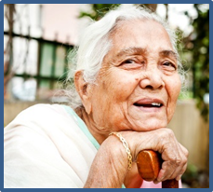
Outline
Why Address Diversity in Dementia?
Conditions and Factors That Influence Rates of Dementia
Dementia Across Sex, Race, and Ethnicity
  Sex
  Black/African American
  Hispanic/Latino
  Asian American
  American Indian/Alaska Native
  Native Hawaiian/Other Pacific Islander
Dementia in Other Unique Populations

Slide 4
Learning Objectives
After completing this module, participants will be able to:
Identify ways that sex, ethnicity, or race influences risk of dementia.
Discuss factors to consider when diagnosing and treating dementia in diverse populations.
Identify barriers to optimal care among various different groups.
Discuss techniques for effective communications with diverse populations.

Slide 5
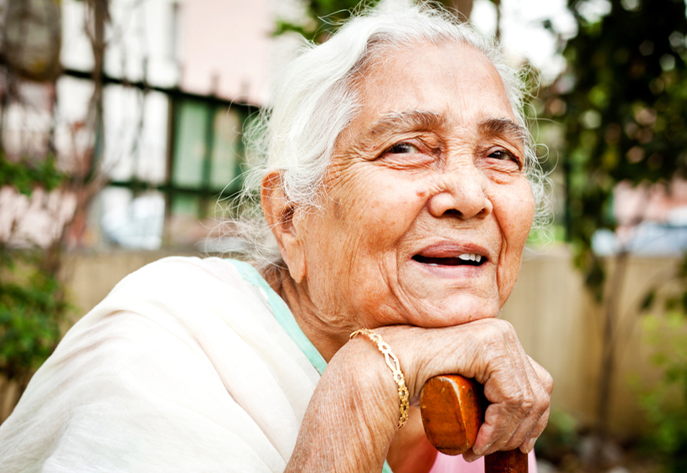
Photo - Senior woman resting

Slide 6
Key Take-Home Messages
“One size does not fit all.”
An attitude of cultural humility plus cultural competence is helpful when working with diverse older persons.
Numerous avenues are available for providers to sharpen their skills for providing care to the increasingly diverse U.S. population of older adults.

Slide 7
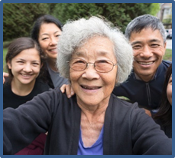
Outline 2 – Why Address Diversity in Dementia?
Why Address Diversity in Dementia?
Conditions and Factors That Influence Rates of Dementia
Dementia Across Sex, Race, and Ethnicity
    Sex
    Black/African American
    Hispanic/Latino
    Asian American
    American Indian/Alaska Native
    Native Hawaiian/Other Pacific Islander
Dementia in Other Unique Populations

Slide 8
Health Insurance Portability and Accountability Act (HIPAA) Considerations
There is little concrete guidance to assist providers in providing care to persons who identify with ethnoracially (where national heritage and ethnic identity are blended) diverse groups.
It is recommended that providers whose care populations include ethnoracially diverse populations familiarize themselves with the cultural beliefs and family dynamics of those groups.
The provision of information and care needs to be HIPAA compliant (U.S. HHS, 2003).

Slide 9
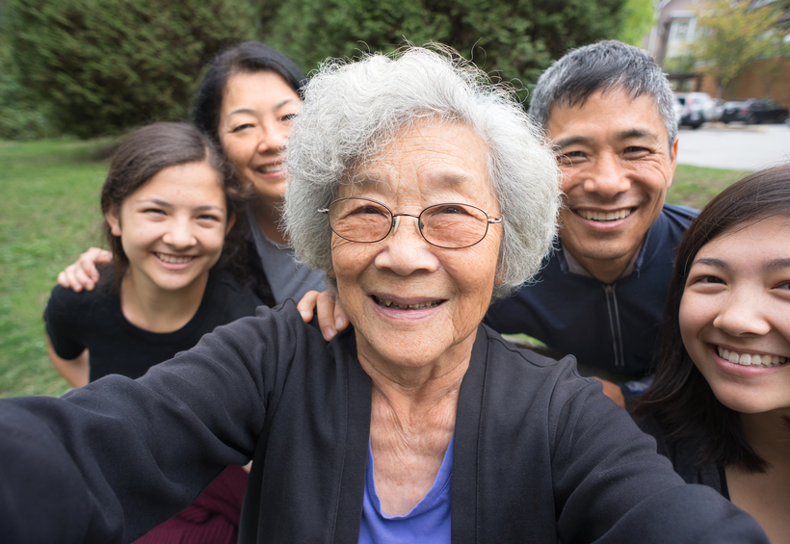
Photo - Senior woman and family

Slide 10
Introduction: Why Address Diversity in Dementia?
Ethnogeriatric imperative (Yeo, 2009)
Within the next few decades, an increasing percentage of the older American population is expected to be from 1 of 4 ethnically diverse racial populations—Black/African American, Asian American, Native Hawaiian/Other Pacific Islander, and American Indian/Alaska Native (AGS, 2016; U.S. Census Bureau, 2014).
  Hispanic/Latino is ethnicity, not race (U.S. Census Bureau, 2014).

Slide 11
Diversity in Dementia: Key Points
Dementia is influenced by many aspects of diversity (Chin et al., 2011).
Race and ethnicity are the most well studied (Chin et al., 2011).
  Medical, lifestyle, and socioeconomic factors as well as utilization of the health care system are all important factors in risk, incidence, and prevalence of dementia (Chin et al., 2011; Smedley et al., 2003; Yeo, 2009).
  The Institute of Medicine (2003) points out that these factors are very real and society has an obligation to recognize and address them.

Slide 12
Diversity in Dementia: Key Points (continued)
Racial and cultural beliefs influence diagnosis and treatment of dementia in the United States (Chin et al., 2011).
There are differences in diverse groups regarding treatment of dementia (Cooper et al., 2010).
There are differences in caregiving and informant participation (Rovner et al., 2013).

Slide 13
Defining the Terms: Race Versus Ethnicity
Race: Person’s physical characteristics, such as bone structure and skin, hair, or eye color (U.S. Census Bureau, 2014)
Ethnicity: Cultural factors, nationality, and ancestry

Slide 14
Defining the Terms: Incidence Versus Prevalence
Incidence: Measures how fast disease occurs and proportion of population developing new cases (Greenberg et al., 2015)
  Many factors influence incidence—including medical and socioeconomic circumstances (Satizabal et al., 2016)
Prevalence: Measures proportion of population with disease

Slide 15
Defining the Terms: Gender Identity Versus Sexual Orientation
Sex refers to a person’s biological status (generally male, female, or intersex) (APA, 2011).
Gender refers to the attitudes, feelings, and behaviors culturally associated with biological sex.
Gender identify refers to one’s “sense of self as male, female, or transgender” (APA, 2011).
Sexual orientation refers to the “sex of those to whom one is sexually and romantically attracted” (APA, 2011).

Slide 16
Disparities in Health Care
There are many disparities in access to and type of health care (Yeo, 2009).
  Differences in rates of illness by race and ethnicity (Smedley et al., 2003)
  Many barriers to accessing health care
There are differences in patient perceptions of care (Smedley et al., 2003; IOM, 2012; Yeo, 2009).
Quality of care improves when communication and other barriers are removed.

Slide 17
General Barriers to Assessment
Barriers to assessing for dementia among ethnically diverse persons with dementia include:
  Inappropriate or language incongruent cognitive tests (Chin et al., 2011).
  Few guidelines for using interpreters.
  Limited how-to instructions on providing diagnosis and treatment in a culturally appropriate manner.

Slide 18
Recommendations from the American Geriatrics Society’s (AGS) Ethnogeriatrics Committee
2016 AGS Ethnogeriatrics Committee developed a set of culturally sensitive indicators to facilitate optimal care (AGS, 2016).
Component of geriatrics that considers the influence of ethnicity and culture on the health and well-being of older adults.
It takes into consideration ethnicity, preferred language, and cultural issues.

Slide 19
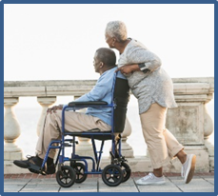
Outline 3 - Conditions and Factors that Influence Rates of Dementia
Why Address Diversity in Dementia?
Conditions and Factors That Influence Rates of Dementia
Dementia Across Sex, Race, and Ethnicity
    Sex
    Black/African American
    Hispanic/Latino
    Asian American
    American Indian/Alaska Native
    Native Hawaiian/Other Pacific Islander
Dementia in Other Unique Populations

Slide 20
Conditions and Factors That Influence Rates of Dementia
Genetic factors
Medical conditions (Hendrie et al., 2017; 2018; Murray et el., 2018)
Ethnic/racial disparities (Gottesman et al., 2015; Mortimer, 2012; White et al., 2016)

Slide 21
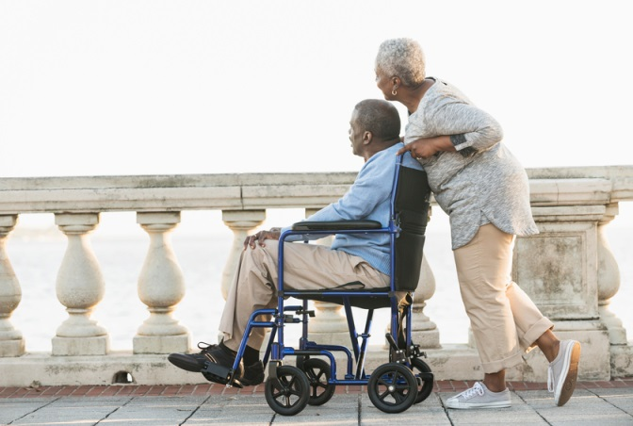
Photo - Woman pushing man on wheelchair

Slide 22
Genetic Factors: APOE-ε4 and Race
Large study of Medicare beneficiaries without dementia found differences in APOE-ε4 allele across races and ethnicities (Tang et al., 1998).
The presence of an APOE-ε4 allele was a determinant of Alzheimer’s disease risk in Whites but that Black/African Americans and Hispanics have an increased frequency of Alzheimer’s disease regardless of their APOE status.

Slide 23
Hypertension and Other Cardiovascular Factors
Statistics from the American Heart Association, American Stroke Association (Mozaffarian et al., 2016), and other studies show racial and ethnic differences in hypertension and cardiovascular risk factors for dementia (CDC, 2018; Delgado et al., 2012; Haan et al., 2003).
  Nearly half of all Black/African American adults have some form of cardiovascular disease, 48 percent of women and 46 percent of men.
  Black/African Americans have nearly twice the risk for a first-ever stroke than do Whites and a much higher death rate from stroke.
  About 43 percent of Americans have total cholesterol of 200 mg/dL or higher—including 41 percent of Black/African American women and 37 percent of Black/African American men.
  Rates of hypertension among Black/African Americans are among the highest of any population in the world.
  Proactive identification and management of cardiovascular risk factors may be the best current dementia prevention strategy.

Slide 24
Diabetes as Independent Risk Factor for Cognitive Impairment
Diabetes is an independent risk factor for cognitive decline (Mayeda et al., 2013, 2014).
26% of people ages 65 and older in the United States have diabetes; rates differ by race/ethnicity (ADA, 2086).
  Diabetes is associated with poorer cognitive performance, regardless of race and ethnicity (Bangen et al., 2015).
Large-scale multiethnic study identified nearly 22,200 patients with diabetes and without dementia that were followed over 10 years (Mayeda et al., 2013, 2014):
  17% of persons were diagnosed with dementia during study period.
  Rates differed by race/ethnicity.

Slide 25
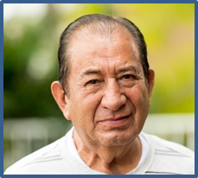
Outline 4 - Dementia Across Sex, Race, and Ethnicity
Why Address Diversity in Dementia?
Conditions and Factors That Influence Rates of Dementia
Dementia Across Sex, Race, and Ethnicity
    Sex
    Black/African American
    Hispanic/Latino
    Asian American
    American Indian/Alaska Native
    Native Hawaiian/Other Pacific Islander
Dementia in Other Unique Populations

Slide 26
Rates of Dementia Vary by Sex, Race, and Ethnicity: Overview
Ethnicity may influence dementia through age of onset, comorbidities, family history, APOE gene status, and cognitive changes over time (Chen & Panegyres, 2016).
Lifestyle, health factors, and education level may have substantial influence on risk of dementia (Chin et al., 2011; Yaffe et al., 2013).
Many studies highlight different rates of dementia by race and ethnicity (Dilworth-Anderson et al., 2008; Chen & Panegyres, 2016; Gurland et al., 1999; Manly & Mayeux, 2004; Mayeda et al., 2016; Potter et al., 2009).

Slide 27
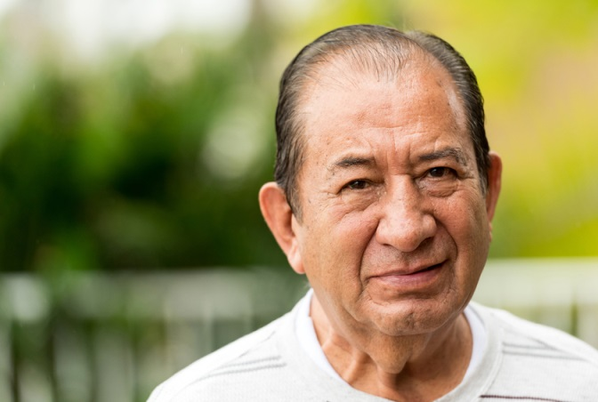
Photo - Senior man

Slide 28

Outline 5 - Sex
Why Address Diversity in Dementia?
Conditions and Factors That Influence Rates of Dementia
Dementia Across Sex, Race, and Ethnicity
    Sex
    Black/African American
    Hispanic/Latino
    Asian American
    American Indian/Alaska Native
    Native Hawaiian/Other Pacific Islander
Dementia in Other Unique Populations

Slide 29
Rates of Dementia by Sex
More women than men have Alzheimer’s disease and related dementias (Hebert et al., 2013; Plassman et al., 2007).
Many explanations have been offered for gender disparities in dementia.
  Women live longer (Hebert et al., 2001; Seshadri et al., 1997).
  Men have a high death rate from cardiovascular disease (Chêne et al., 2015).
  Lack of significant difference in incidence by sex suggests life experience may be an important factor in disparity (Carter et al., 2012).
  Difference may be possible in strength of genetic factor (the APOE-ε4 genotype) between the sexes (Altmann et al., 2014; Kang & Grodstein, 2012; Unger et al., 2014; Yaffe et al., 2000)

Slide 30

Photo - Senior woman holding face

Slide 31

Outline 6 - Black/African American
Why Address Diversity in Dementia?
Conditions and Factors That Influence Rates of Dementia
Dementia Across Sex, Race, and Ethnicity
    Sex
    Black/African American
    Hispanic/Latino
    Asian American
    American Indian/Alaska Native
    Native Hawaiian/Other Pacific Islander
Dementia in Other Unique Populations

Slide 32
Dementia Prevalence and Incidence Among Black/African Americans
Genetic risk factors increase risk in Black/African Americans (Logue et al., 2011; Reitz et al., 2013).
Higher risk and rates of diabetes are evident among Black/African Americans (Mayeda et al., 2014; Mozaffarian et al., 2016; Peek et al., 2007).
Social and cultural factors increase risk of dementia among Black/African Americans (Chui & Gatz, 2005; Rovner et al., 2013).
Higher prevalence of vascular dementia is evident among Black/African Americans compared with Caucasians (Fitzpatrick et al., 2004; Miles et al., 2001).
The risk of Parkinson’s disease is possibly lower among Black/African Americans than it is among other groups (McInerney-Leo et al., 2004; Miles et al., 2001; Rajput et al., 2003).

Slide 33

Photo - Nurse holding senior woman’s hand

Slide 34
Risk Factors for Dementia Among Black/African Americans
Black/African Americans appear to have greater likelihood of a missed diagnosis of Alzheimer’s disease than do non-Hispanic Whites (Barnes & Bennett, 2014).
  Many reasons are offered including inequalities of diagnostic tools, underreporting, diagnosis at later stages, and lack of representation in clinical trials.
  Delayed/missed diagnoses or misdiagnoses lead to delays in treatment.
  Black/African Americans have higher rates medical conditions associated with dementia: hypertension (Delgado et al., 2012; Mozaffarian et al., 2016), diabetes (Mayeda et al., 2014; Mozaffarian et al., 2016), and HIV infection (SAMHSA, 2016).

Slide 35
Dementia Assessment Issues Among Black/African Americans
Many general barriers to discussing possible diagnosis (Gleason et al., 2015)
Challenges in using available assessment tools that are linked with educational attainment (Garrett et al., 2013; O’Bryant et al., 2008; Spering et al., 2012)
Recommend combining assessment tools to obtain more accurate results (Tappen et al., 2012)

Slide 36
Dementia Treatment Issues Among Black/African Americans
Be aware of comorbid conditions commonly found in Black/African Americans.
Recognize any hesitation and unease of the Black/African American population with the health care system.
Realize that current treatment is based on studies that excluded Black/African Americans, despite apparent differences in survival and rates of decline (Barnes & Bennett, 2014).
Understand that there are significant disparities in pharmacologic treatment of dementia for Black/African Americans (Gilligan et al., 2012).

Slide 37
Dementia Care Partner Issues for Black/African Americans
Care partners for Black/African Americans with dementia are less likely to be spouses (Family Caregiver Alliance, 2016) and often younger and less educated with minimal financial resources.
Black/African American care partners have higher rate of unhealthy behaviors than non-Hispanic White care partners (Haley et al., 2004).
Caregiving appears to be more rewarding to Black/African Americans than it is to non-Hispanic Whites (Heo & Koeske, 2013; Roth et al., 2015).
There are benefits of training for care partners (Belle et al., 2006).

Slide 38
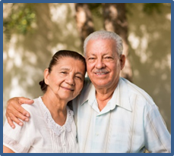
Outline 7 - Hispanic/Latino
Why Address Diversity in Dementia?
Conditions and Factors That Influence Rates of Dementia
Dementia Across Sex, Race, and Ethnicity
    Sex
    Black/African American
    Hispanic/Latino
    Asian American
    American Indian/Alaska Native
    Native Hawaiian/Other Pacific Islander
Dementia in Other Unique Populations

Slide 39
Dementia Prevalence Among Hispanic/Latino Americans
Many diverse cultures make up Hispanic/Latino communities.
These cultures have the fastest growing elderly population in the United States (U.S. Census Bureau, 2014).
Members of these communities have longer life expectancy than those in the general U.S. population (Haan et al., 2003).
Hispanic/Latino Americans also have an onset of dementia at a younger age (Fitten et al., 2014).

Slide 40
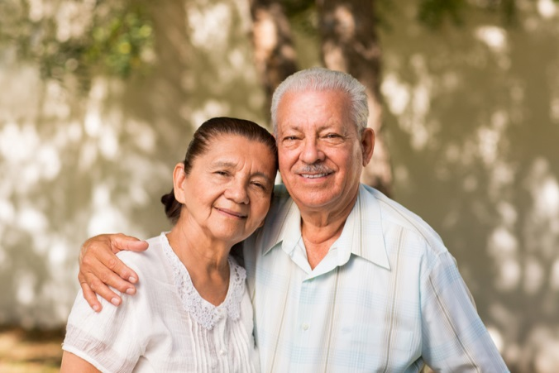
Photo - Senior Hispanic Couple

Slide 41
Risk Factors for Dementia Among Hispanic/Latino Americans
Lower frequency of APOE ε4 allele in Hispanics/Latinos (Haan et al., 2003)
Dementia in this group may be related to preventable (vascular) causes more than it is with Americans of European descent (Haan et al., 2003).
Numerous socioeconomic factors increase the risk (Haan et al., 2003)

Slide 42
Dementia Assessment Issues Among Hispanic/Latino Americans
Many live below the poverty line (DeNavas et al., 2011).
Many don’t seek medical care because of financial and language barriers (Arguelles & Arguelles, 2006; Montoro-Rodriguez et al., 2006; Talamantes et al., 2006).
Many rely on their families for assistance (Angel et al., 2014).
There is a validated Spanish and English neuropsychological test battery (Mungas et al., 2000, 2004, 2005a, 2005b).

Slide 43
Dementia Treatment Issues Among Hispanic/Latino Americans
Many vascular and other medical risk factors increase the risk of dementia (Haan et al., 2003; Mayeda et al., 2013; Mozaffarian et al., 2016; Schneider et al., 2015; West & Haan, 2009).
Obesity
Type 2 diabetes mellitus
Hypercholesterolemia
Hypertension

Slide 44
Dementia Care Partner Issues for Hispanic/Latino Americans
There is a need for cultural sensitivity in diagnosis and treatment (Arguelles & Arguelles, 2006; Montoro-Rodriguez et al., 2006; Oakes & Talamantes, 2011; Talamantes et al., 2006).
Recommendations for health care interventions with Hispanic and Latino family care partners include (Arguelles & Arguelles, 2006; Montoro-Rodriguez, Small, & McCallum, 2006; Talamantes, Trejo, Jimenez, & Gallagher-Thompson, 2006):
  Addressing the elder patient by his or her last name.
  Communicating indirectly through the son or oldest child.
  Having limited or indirect eye contact.
  Reserving closer contact until familiarity is established.
  Teaching the care partner adaptive coping skills.

Slide 45
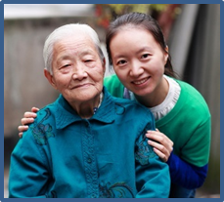
Outline 8 - Asian American
Why Address Diversity in Dementia?
Conditions and Factors That Influence Rates of Dementia
Dementia Across Sex, Race, and Ethnicity
    Sex
    Black/African American
    Hispanic/Latino
    Asian American
    American Indian/Alaska Native
    Native Hawaiian/Other Pacific Islander
Dementia in Other Unique Populations

Slide 46
Chinese Americans: Overview
Chinese Americans are the largest Asian group in the United States—at least 3.3 million persons (U.S. Census Bureau, 2014).
Approximately 1 in 10 Chinese Americans are ages 65 and older.
Chinese American culture is of utmost importance in medical decision-making (Braun & Browne, 1998; Wang et al., 2006).

Slide 47
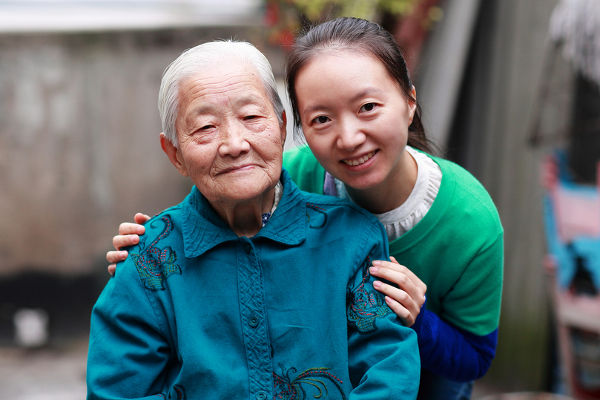
Photo - Senior Asian American

Slide 48
Dementia Among the Chinese American Population
Many misconceptions about dementia exist, including lack of a specific word for dementia in the Chinese language (Dick et al., 2006).
Memory problems are believed to be normal aging, delaying diagnosis (Wang et al., 2006).
There is a focus on psychoeducation not psychotherapy to engage Chinese Americans in treatment.

Slide 49
Barriers to Assessment and Treatment Among Chinese Americans
Linguistic and cultural barriers make it difficult to test for cognitive impairment and to interpret results (Dick et al., 2006; Lin et al., 2012; Wang et al., 2006).
Recommended adjustments include:
  Using screening tools that have been validated for Chinese American older adults
  Considering the person’s first language.
  Being aware that some words used or required in cognitive tests do not exist in the Chinese language.
  Using a paint brush rather than a pencil; this may yield more culturally fair results.
  Using more than one instrument for cross-validity.

Slide 50
Influence of Chinese Cultural Values on Dementia
Chinese cultural beliefs may interfere with willingness to seek diagnosis and treatment for dementia.
“Saving face” is important in light of dementia.
Caring for one’s elders is a moral and social responsibility (Wang et al., 2006).

Slide 51
Dementia Among the Filipino American Population
Filipino American population totals approximately 2.65 million persons, and nearly 16% are older than 70 (Hoeffel et al., 2012).
  It is the second fastest growing Asian American group in the U.S. (Hoeffel et al., 2012).
This population has many risk factors for dementia (Sy et al., 2007; WHO, 2002; Zuliani et al., 2010).
Cultural values influence diagnosis (Boustani et al., 2003) and treatment (McBride, 2006a, 2006b).

Slide 52
Dementia Among the Vietnamese American Population
Vietnamese American population is smaller than that of Chinese or Indian Asian American populations, at just under 1.55 million persons (U.S. Census Bureau, 2014).
Most identify as either Buddhist or Catholic/Christian .
Symptoms are perceived to be part of normal aging (Tran et al., 2010), but diagnosis of dementia brings shame to the entire family (Braun et al., 1996), and dementia is seen as mental illness (Yeo et al., 2001).
Diagnosis causes self-isolation of the person and family (Hinton, 2002; Hinton et al., 2005).
Diagnosis and treatment should be conducted within Vietnamese cultural norms.

Slide 53
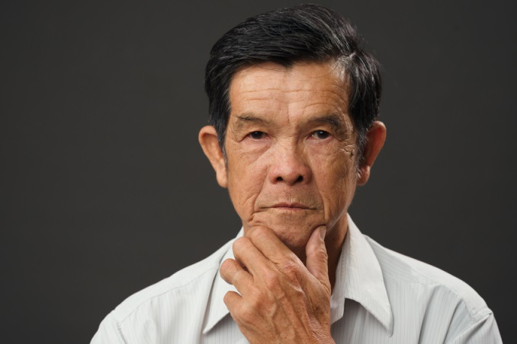
Photo - Vietnamese senior man

Slide 54
Dementia Among the Korean American Population
More than 1.4 million Koreans are in the United States (U.S. Census Bureau, 2014), but the prevalence of dementia among this population is unknown. In Korea, prevalence ranges from 7.4 to 13.0% (Kim et al., 2003).
Dementia is a cultural stigma and shame (Lee et al., 2010; Moon, 2006).
Awareness of available treatments and resources is low among the Korean community (Chee & Levkoff, 2001; Lee, 2006; Moon, 2006).
Cultural and language barriers to optimal care include low health literacy and lack of trust (Jang et al., 2005, 2007).
Family is the primary source of caregiving (Han et al., 2008; Kim & Theis, 2000).

Slide 55
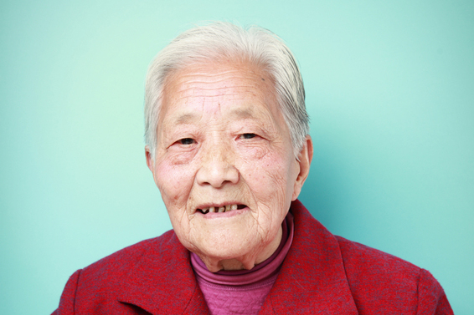
Photo – Korean senior woman

Slide 56
Dementia Among the Japanese American Population
Slow influx of Japanese Americans and high rate of intermarriage have led to only 760,000 Japanese Americans living in the United States (U.S. Census Bureau, 2014).
Lack of information is attributed to hesitancy or shame of dementia in the family (Braun & Brown, 1998).
Providers should recognize and acknowledge traditional cultural values for diagnosis and management.

Slide 57
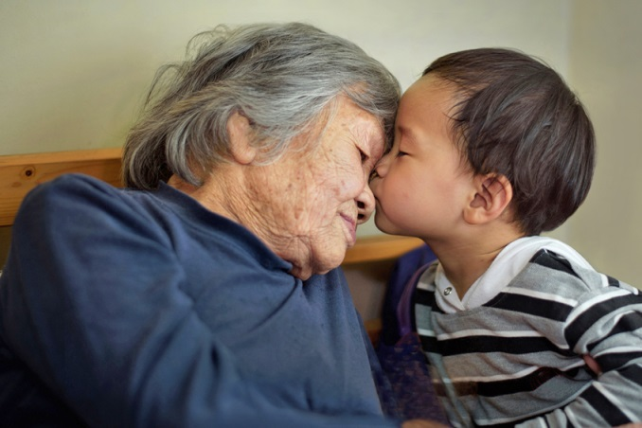
Photo - Japanese senior woman with grandson

Slide 58
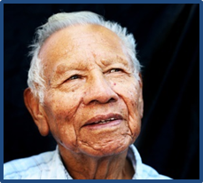
Outline 9 - American Indian/Alaska Native
Why Address Diversity in Dementia?
Conditions and Factors That Influence Rates of Dementia
Dementia Across Sex, Race, and Ethnicity
    Sex
    Black/African American
    Hispanic/Latino
    Asian American
    American Indian/Alaska Native
    Native Hawaiian/Other Pacific Islander
Dementia in Other Unique Populations

Slide 59
American Indians/Alaska Natives
American Indians/Alaska Natives are one of fastest growing U.S. populations, at 5.2 million people (Garrett et al., 2015).
Prevalence and incidence data differ by tribe and group.
They are considered an “invisible” ethnically diverse group (Garrett et al., 2015).
They have a much higher risk of dementia compared with Asian Americans among those with diabetes, 40 to 60% higher (Mayeda et al., 2014).
They do not have a strong genetic risk (Tang et al., 1998), but they do have a high rate of diabetes (Trief, 2007).
Barriers to diagnosis and treatment include:
  Dementia is seen as a spiritual or psychological problem.
  Caregiving is kept within the family (Garrett et al., 2015).
  Lack of younger persons to provide care, leads to institutionalization at an earlier stage (Garrett et al., 2012, 2015).

Slide 60
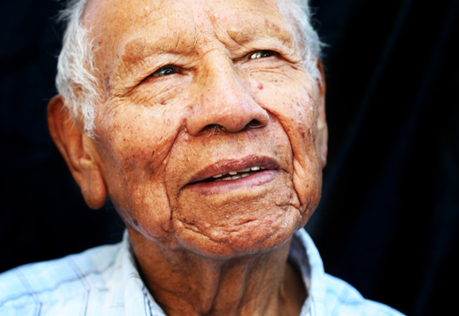
Photo - American Indian senior man

Slide 61
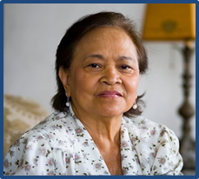
Outline 10 - Native Hawaiian/Other Pacific Islander
Why Address Diversity in Dementia?
Conditions and Factors That Influence Rates of Dementia
Dementia Across Sex, Race, and Ethnicity
    Sex
    Black/African American
    Hispanic/Latino
    Asian American
    American Indian/Alaska Native
    Native Hawaiian/Other Pacific Islander
Dementia in Other Unique Populations

Slide 62
Native Hawaiian and Pacific Island Elders
Native Hawaiians/Other Pacific Islanders are often grouped with Asian Americans and Pacific Islanders but have significant health disparities compared with other Asian American groups (Braun et al., 2015).
Native Hawaiians/Other Pacific Islanders make up only 0.4% of U.S. population (U.S. Census Bureau, 2014).
Socioeconomic factors include low income, high poverty rate, short life expectancy, and high rates of obesity.
Despite risk factors, Native Hawaiians/Other Pacific Islanders tend to stay within their families and church to manage persons with dementia (Braun et al., 2015).

Slide 63
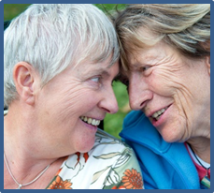
Outline 11 - Dementia in Other Unique Populations
Why Address Diversity in Dementia?
Conditions and Factors That Influence Rates of Dementia
Dementia Across Sex, Race, and Ethnicity
    Sex
    Black/African American
    Hispanic/Latino
    Asian American
    American Indian/Alaska Native
    Native Hawaiian/Other Pacific Islander
Dementia in Other Unique Populations

Slide 64
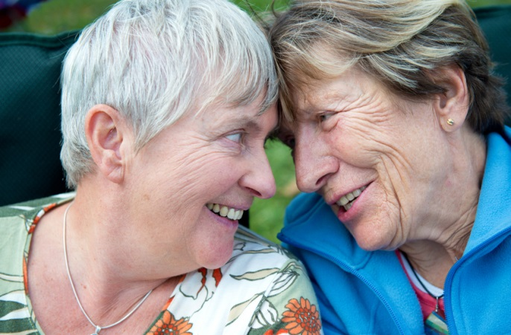
Photo - Two senior women

Slide 65
Dementia Among the Lesbian, Gay, Bisexual, and Transgender (LGBT) Communities: Prevalence
Many LGBT persons do not disclose their orientation or gender identity, even to their primary care provider (Eskenazi & Family Caregiver Alliance, 2015).
  Fewer than 3.5% identify as other than straight (Gates, 2011; Gates & Newport, 2012; Ward et al., 2014).
  It is difficult to establish statistics on prevalence.
  The number of older LGBT adults is expected to grow from 3 million currently to 6 million by 2050 (Pew Research Center, 2010).

Slide 66
Barriers to Assessment, Diagnosis, and Caregiving of LGBT Persons Living with Dementia
Lack of access to high-quality health care (Fredriksen-Goldsen et al., 2013)
Lack of disclosure leads to incomplete assessment and inadequate communications with health care professionals (Fredricksen-Goldsen et al., 2013; LGBT Program Partnership, 2015).
Lack of services and equal access to benefits (Fredriksen-Goldsen, 2007; Mazey, 2015)
Unique issues regarding provision of care for LGBT individuals (Gurnon, 2016)

Slide 67

Photo – Two men holding hands

Slide 68
Dementia Risk Factors Associated with the Lesbian, Gay, Bisexual, and Transgender (LGBT) Communities
An Institute of Medicine report on lesbian, gay, bisexual, and transgender (LGBT) health noted higher rates of depression, suicidal thoughts and attempts, substance use and abuse, and discrimination and stigma in LGBT communities compared with heterosexual peers (IOM, 2011).
Although 91% of LGBT persons engage in wellness activities, a high percentage has been denied health care and 1 in 5 fail to disclose orientation/identity to their doctor (Fredriksen-Goldsen et al., 2013).
LGBT persons have higher risk for unhealthy behaviors and disabilities (Fredriksen-Goldsen, 2011; Fredriksen-Goldsen et al., 2013).
They also have an increased risk of experiencing the impact of HIV/AIDS and HIV-Associated Neurocognitive Disorder (Cahill & Valadez, 2013; Marra et al., 2013; Tozzi et al., 2003), particularly transgender persons (Mesics, 2016).

Slide 69
Barriers to Care in Rural America
Include geographical isolation, lack of care facilities, transportation difficulties, and high cost of care.
Underreporting, underdiagnosis, and undertreatment of dementia are common among persons living in rural America (Cahil et al., 2008; Kosteniuk et al., 2014; Liu et al., 2009; Stark et al., 2013).
Rural Americans lack medical support and have limited access to specialists and to medical and support services (Dal Bello-Haas et al., 2014a, 2014b; Forbes et al., 2012; Kosteniuk et al., 2014; Orpin et al., 2014).

Slide 70
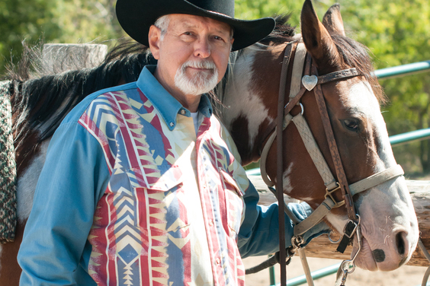
Photo - Man with Horse

Slide 71
Dementia and Intellectual Disabilities
Approximately 6.5 million persons in the United States have an intellectual disability. Of these are 180,000 older adults, of which an estimated 11,000 may be affected by dementia (NTG, 2012)
Adults with Down syndrome are at high risk for Alzheimer’s disease and then Alzheimer’s dementia (Prasher, 2005)
About 70% of persons with Down syndrome develop Alzheimer’s disease (Beaumont & Carey, 2011; Glasson et al., 2014; Hartley et al., 2015; McCarron et al., 2014) for reasons not yet understood (Prasher, 2005; Strydom et al., 2013).
  Virtually all develop Alzheimer’s disease neuropathology beginning in their 30s (Carr, 2012; Furniss et al., 2012; Hartley et al., 2015), but not all manifest dementia before death.
The rates of Alzheimer’s disease and other dementias among PLwD with other intellectual disability are about the same as for other PLwD.

Slide 72
Dementia and Intellectual Disabilities (continued)
Many barriers to early and appropriate diagnosis and care management exist, but specialized services can be accessed from state and local disability agencies (Beaumont & Carey, 2011; Dodd et al., 2017; Hutchinson & Oakes, 2011; Jokinen et al., 2013; Strydom et al., 2013; Urv et al., 2010).
Generally the same types of service needs apply to adults with dementia and intellectual disability as are found in other PLwD (NTG, 2012).
  There are common issues, such as housing, day activities, end-of-life care, abuse and neglect, residential care supports, health declines, financial supports, and assistive technology needs
In lieu of continued care at family home, next best option of comfort for families is use of small group home settings for PLwD and intellectual disability

Slide 73
Evaluation
Rates of dementia differ by race and ethnicity and are related to all but which of the following?
  Level of education
  Utilization of health care
  Lifestyle factors
  Geographic location within the United States
Black/African Americans appear to have lower rates of which type of dementia?
  Alzheimer’s disease
  Vascular dementia
  Parkinson’s disease dementia
  Mixed dementia

Slide 74
Evaluation (continued 1)
Which of the following explains why Chinese Americans often delay seeking diagnosis of dementia?
  Their belief that memory problems are a normal part of aging
  The belief that dementia is a psychiatric illness that is an embarrassment to the family
  The lack of language-appropriate assessment tools
  The stigma against taking Western medicines

Slide 75
Evaluation (continued 2)
Which of the following is standard protocol when discussing a diagnosis of or treatment for dementia with persons of ethnoracially diverse populations?
  Always try to talk directly with the person living with dementia
  Always try to make eye contact with the person living with dementia from the initial visit
  Try to understand the family hierarchy before addressing the older person living with dementia
  All of the above

Slide 76
Acknowledgements
This module was prepared for the U.S. Department of Health and Human Services (HHS), Health Resources and Services Administration (HRSA), by The Bizzell Group, LLC, under contract number HHSH25034002T/HHSH250201400075I.
The dementia and education experts who served on the Dementia Expert Workgroup to guide the development of the modules included: Alice Bonner, PhD, RN, FAAN, Secretary Elder Affairs, Massachusetts Executive Office of Elder Affairs, Boston MA; Laurel Coleman, MD, FACP, Kauai Medical Clinic - Hawaii Pacific Health, Lihue, HI; Cyndy B. Cordell, MBA, Director, Healthcare Professional Services, Alzheimer's Association, Chicago, IL; Dolores Gallagher Thompson, Ph.D., ABPP, Professor of Research, Department of Psychiatry and Behavioral Sciences, Stanford University School of Medicine, Stanford, CA; James Galvin, MD, MPH, Professor of Clinical Biomedical Science and Associate Dean for Clinical Research, Florida Atlantic University, Boca Raton, FL; Mary Guerriero Austrom, PhD, Wesley P Martin Professor of Alzheimer's Disease Education, Department of Psychiatry, Associate Dean for Diversity Affairs, Indiana University-Purdue University Indianapolis, Indianapolis, IN; Robert Kane, MD, Professor and Minnesota Chair in Long-term Care & Aging, Health Policy & Management, School of Public Health, University of Minnesota; Jason Karlawish, MD, Professor of Medicine, Perelman School of Medicine, University of Pennsylvania; Helen M. Matheny, MS, APR, Director of the Alzheimer's Disease Outreach Program, Blanchette Rockefeller Neuroscience Institute, Morgantown, WV; Darby Morhardt, PhD, LCSW, Associate Professor, Cognitive Neurology and Alzheimer's Disease Center and Department of Preventive Medicine, Northwestern University Feinberg School of Medicine, Northwestern University, Chicago, IL; Cecilia Rokusek, EdD, MSc, RDN, Assistant Dean of Research and Innovation, Professor of Family Medicine, Public Health, Nutrition, and Disaster and Emergency Preparedness, College of Osteopathic Medicine, Nova Southeastern University, Fort Lauderdale, FL. Additional expertise in the development of the modules was provided by Meg Kabat, LCSW-C, CCM; Eleanor S. McConnell, PhD, MSN, RN, GCNS, BC; Linda O. Nichols, PhD, MA, BA; Todd Semla, MS, PharmD, BCPS, FCCP, AGSF; Kenneth Shay, DDS, MS, from the U.S. Department of Veterans Affairs and Seth Keller, MD and Matthew P. Janicki, PhD, National Task Group on Intellectual Disabilities and Dementia Practices.

Slide 77


Brought to you by the
U.S. Department of Health and Human Services, Health Resources and Services Administration

