Slide 1
About Nurse Corps
The Nurse Corps offers programs to help address shortages of nurses across the country. These include:
loan repayment to nurses who work in facilities experiencing a critical shortage of nurses;
loan repayment to nurse faculty; and
scholarships to students enrolled—or accepted for enrollment—in nursing degree programs.
LOAN REPAYMENT PROGRAM
SCHOLARSHIP PROGRAM
Notes:
Through Nurse Corps, we have helped underserved areas meet their urgent need for nurses since 2002.

Slide 2
Nurse Corps Field Strength
The Nurse Corps program helps alleviate the critical shortage of nurses in high-need areas across the U.S. and its territories.
Currently, there are more than 3,900 Nurse Corps participants serving at over 2,500 sites.
Nurse Corps participants provide care to more than 4 million patients annually in urban, rural, and tribal areas.
About 23% of our Nurse Corps clinicians work at a community health center or a community health center look-alike

Slide 3
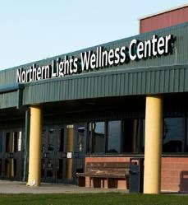
Types of Critical Shortage Facilities (CSF)
Hospitals:
Community-Based Settings:
Disproportionate Share Hospital
Private Hospital
Public Hospital
Ambulatory Surgical Center
American Indian Health Facilities
Community Mental Health Center
End Stage Renal Disease (ESRD) Dialysis Centers
Federally Qualified Health Center
Free and Charitable Clinics
Home Health Agency
Hospice Program
Native Hawaiian Health Center
Nurse Managed Health Clinic/Center
Residential Nursing Home
Rural Health Clinic
Small Rural Hospital
State or Local Health Department
Urgent Care Center

Slide 4
Nurse Corps Loan Repayment Program (1 of 4)
The Nurse Corps offers loan repayment to nurses who work in health centers, rural health clinics, hospitals, and other facilities experiencing a critical shortage of nurses; and to nurse faculty who teach full-time in eligible public or private schools of nursing.
LOAN REPAYMENT PROGRAM

Slide 5
Nurse Corps Loan Repayment Program (2 of 4)
You may be eligible for loan repayment if:
You are:
a licensed registered nurse;
an advanced practice registered nurse, such as a nurse practitioner; or
a nurse faculty member with qualifying nursing debt;
You received your nursing education from:
an accredited school of nursing located in a U.S. state or territory.
You work full-time at:
an eligible Critical Shortage Facility (CSF) in a high need area (for RNs, APNs),
an accredited school of nursing (for nurse faculty).
2+1
2-Year minimum With an optional 3rd year

Slide 6
Nurse Corps Loan Repayment Program (3 of 4)
If awarded, you can pay off up to 85% of your nursing education debt. The program will award 60% of your unpaid nursing student loans in exchange for two years of service.
If you commit to a third year of service, we will award an additional 25% of your original balance.
2+1
2-Year minimum With an optional 3rd year

Slide 7
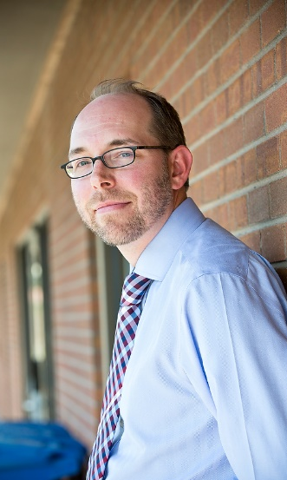
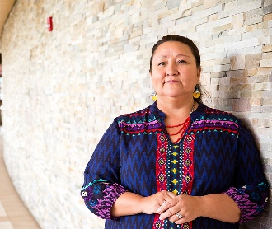
Nurse Corps Loan Repayment Program (4 of 4)
Half of all LRP awards are set aside for nurse practitioners (NPs), who are a critical part of the U.S. primary care workforce.
Of the 50 percent allocated for NPs, up to 20 percent are available for NPs practicing in a psychiatric-mental or behavioral health care capacity.
These allocations expand the integration of mental health, substance use disorder treatment, and other behavioral health services into primary care across the nation.

